Slide 1
what where how and when
PPT By-SK Shandilya
Introduction

Slide 2
What will I learn in this lesson?
This lesson is about what,where,how and when and below are a few things that you will be learning.
the concepts of the past and periods of history
the geographical framework of the earliest civilisations
sources of information used to study the past

Slide 3
Comics
Here is an interesting story with some awesome artwork. Are you ready for this amazing form of storytelling?

Slide 4
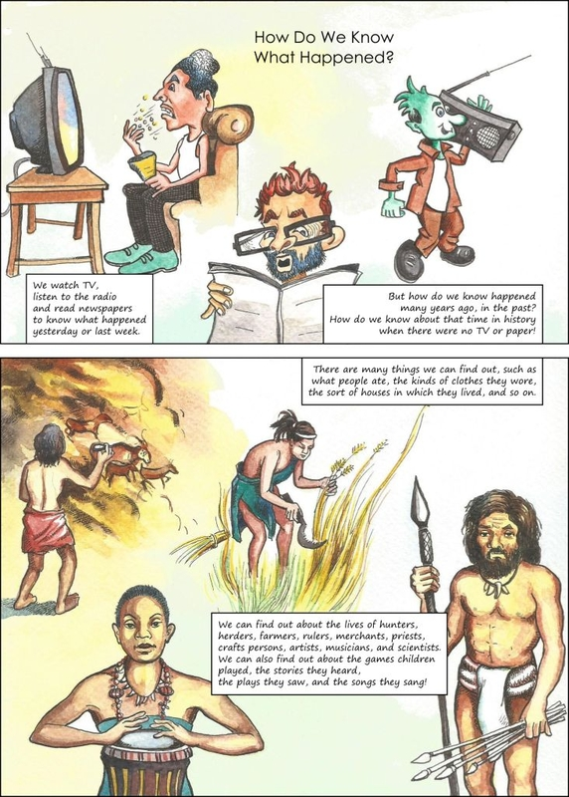

Slide 5
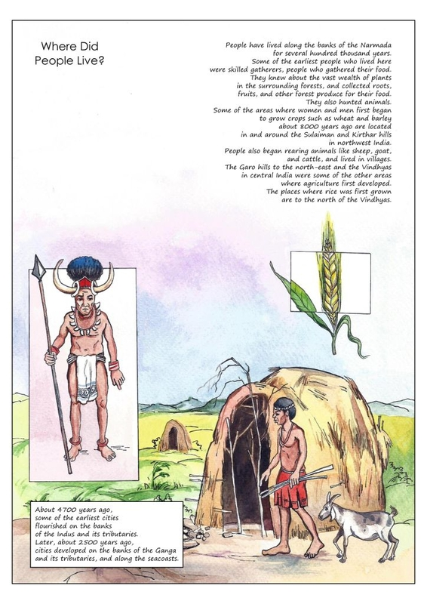

Slide 6
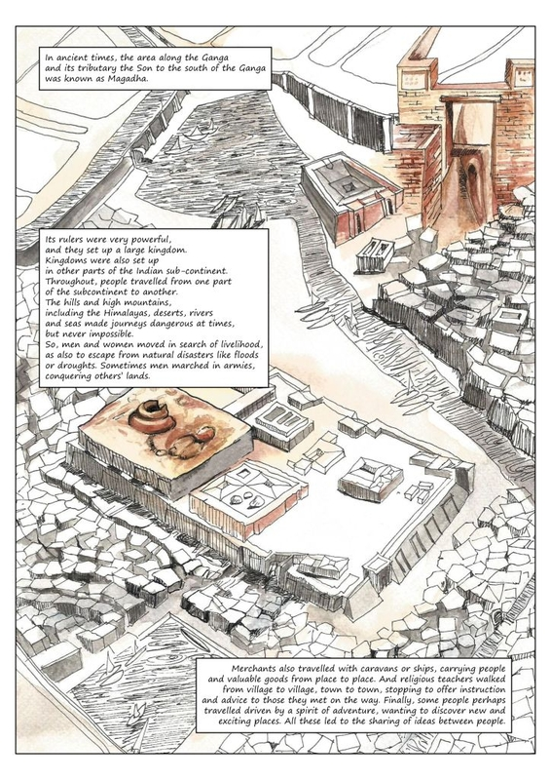

Slide 7
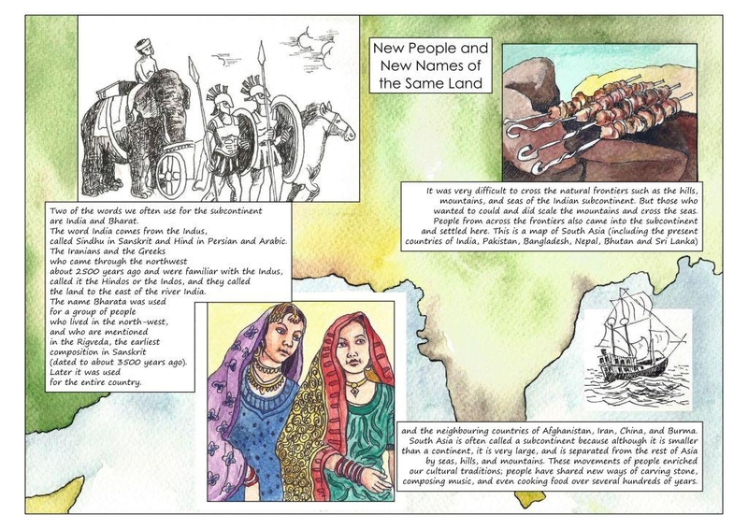

Slide 8
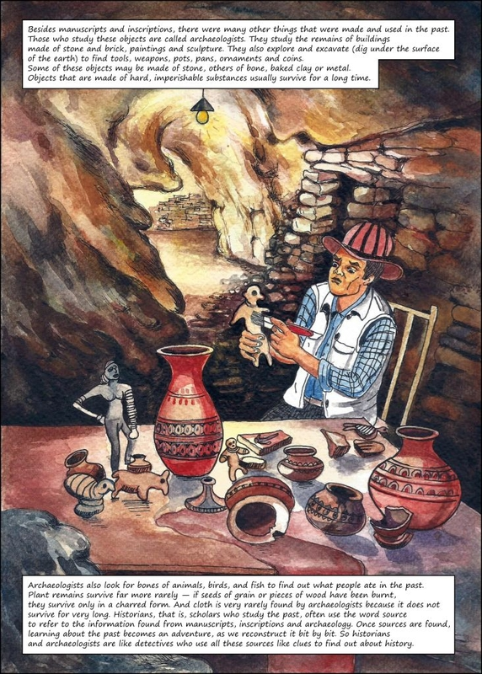

Slide 9
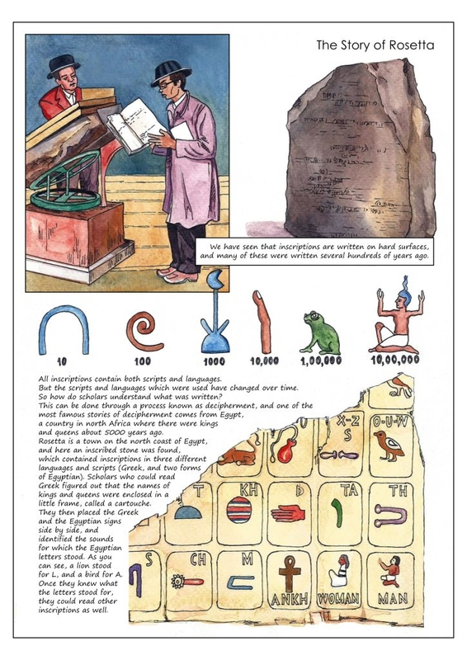

Slide 10
The lives of ancient people, things such as their eating habits, clothes, types of houses they lived in, etc., were very interesting. And we can learn about the earliest farmers, herders, hunters, rulers, merchants, priests, musicians, artists, scientists and craftspeople by conducting research.
People started living on the banks of rivers like Narmada or the Ganges thousands of years ago. At first, they were skilled gatherers and hunters. But because the land around the rivers was very fertile, they settled down and became farmers and animal herders.
This is how society and civilisation started, around 5,000 years ago. And soon, small groups of farmers and herders (near the banks of rivers and their tributaries, and near sea coasts) grew bigger and became villages and cities.

Slide 11
Magadha was one of the sixteen Maha-Janapadas or kingdoms in ancient India. The centre of Magadha was the area of Bihar, south of the Ganges.
People travelled from one part of the subcontinent to another, through hills and mountains, seas and deserts. And they moved to escape war and natural disasters, in search of new livelihoods, to spread their businesses, or to learn and teach about new places and religions. Of course, many people set up new homes in faraway places to enjoy adventure and discovery.
These movements of people enriched (added to) the cultural and social traditions. And we can see many of them around us even today!

Slide 12
Nomenclature (how things are named or labelled)
India is also called Bharat or Hindustan.
The name India is of Greek origin and comes from the river Indus (Sindhu in Sanskrit, Hindu in Persian). Greeks who invaded India from the north-west had to cross the river Indus, and with time, the area to the river's south was named India.
Bharata was the name given to the group of people who lived in the north-west, as mentioned in the Rigveda. And later, the whole country was named after them.

Slide 13
Ways to Learn About the Past
We can get information about the past from various sources such as manuscripts (books handwritten long ago) and inscriptions (writings on hard surfaces such as stone or metal).
Manuscripts were usually written on palm leaves or on the bark of the birch tree. They contained many subjects like religious practices and beliefs, lives of kings, medicines, and science. And they were written as notes, epics, and plays in Sanskrit, Prakrit, or Tamil.
Kings inscribed religious and other messages and orders on stones and metals so that the common people could read and follow them. People also used inscriptions to record major historical events.
Remains of many objects (such as pots, weapons, ornaments, tools, various buildings, paintings, sculptures, coins etc.) are studied by the archaeologists to find out about the past. They also study bones of animals and birds and charred remains of seeds, grains, or wood to find out about what people used to eat.

Slide 14
Different Pasts
Different people, such as kings and farmers, live very different lives. So their pasts must also have been very different. For example, they must have celebrated birthdays in very different ways, or lived in very different types of homes and families.
Kings spent a lot of money to record their lives and wars. But the lives of ordinary people, such as farmers, hunters, herders, gatherers, and craftspeople, are not recorded.
So historians and archaeologists study as many different pasts as they can.

Slide 15
How are dates assigned?
According to the old dating system, dates before the birth of Christ are counted backwards and the letters BC (Before Christ) are added at their end. And for dates after the birth of Christ, AD is added.
But in the new system, we use BCE and CE instead of BC and AD.

Slide 16
Quiz
There are many things we can find out about the past - what people ate, the kinds of clothes they wore, and the houses in which they lived. We can also find out about the lives of the earliest hunters, herders, farmers, rulers, merchants, priests, craftspeople, artists, musicians, and scientists. What else can we find out about the past?
1.games people played
2.plays people enjoyed
3.songs poets wrote
4.all of the above

Slide 17
all of the above

Slide 18
People have lived along the banks of rivers for thousands of years. They knew about the vast wealth of plants in the surrounding forests, and used roots, fruits, honey, and other forest produce. Sometimes, they also hunted animals for food. What were these people known as?
1.skilled gatherers
2.rulers
3.artists
4.merchants

Slide 19
skilled gatherers

Slide 20
Some of the areas where women and men first began to grow crops such as wheat and barley (about 8000 years ago) are located near the Sulaiman and Kirthar hills in the northwest of India. People began living in villages and rearing cattle such as sheep and goats. Agriculture also developed near the Garo hills and the Vindhyas. Where are the Garo hills located?
1.in north-east India
2.in north-west India
3.in south-east India
4.in south-west India

Slide 21
in north-east India

Slide 22
The Sulaiman and Kirthar hills (in the northwest), the Garo hills (in the north-east of India), and the Vindhyas were some of the areas where agriculture first developed; the places where rice was first grown, for example, are to the north of the Vindhyas. Where would you find the Vindhyas on the map of India?
1.in the south-east
2.in the south
3.near the centre
4.in the west

Slide 23
near the centre

Slide 24
About 4,700 years ago, on the banks of rivers, flourished some of the earliest cities on earth. And about 2,500 years ago, cities developed on the banks of the Ganga and its tributaries, and along sea-coasts. In ancient times, what was the fertile area to the south of the Ganga known as?
1.Kurukshetra
2.Magadha
3.Ayodhya
4.Avadh

Slide 25
Magadha

Slide 26
Two of the words we often use for our country are India and Bharat. The Iranians and the Greeks who came through the northwest used the names Hindos or Indos for the river Indus, and they called the land to the east of the river India. So the word India comes from the European word Indus. But what is the original Sanskrit name for the river Indus?
1.Hindu
2.Bindu
3.Sindhu
4.Indu

Slide 27
Sindhu

Slide 28
One way to find out about the past is to search for and read books that were written long ago by hand, known as manuscripts. These were usually written on leaves of the palm tree, or on specially prepared bark of a tree known as the birch which grows in the Himalayas. Why were they called manuscripts?
1.All the manuscripts were dedicated to lord Manu.
2.The meaning of 'manu' in Latin is hand, and to scribe means to write.
3.Lord Manu was the writer of all manuscripts.
4.The meaning of 'manu' in French is hand.

Slide 29
The meaning of 'manu' in Latin is hand, and to scribe means to write.

